Slide 1

Vagrant box management

Slide 2
Managing vagrant boxes and state

Slide 3
Vagrant boxes
Another neat factor that we have with Vagrant boxes is the ability to use and manage multiple boxes simultaneously in a single file.
By now, if you’ve done the lab from part 2, you are familiar with the numerous images that we have available from vagrant (via VMWare, Virtualbox, AWS, Docker, etc).
One of the huge advantages of using Vagrant to manage these images is that we can create a collection of various images on our hard drive for later use.
This saves a TON of download time

Slide 4
Vagrant boxes
A quick and easy way to access new Vagrant boxes from the registry is with the vagrant box add command on the command line (from within a directory where you ran a vagrant init)
So you can easily add a box (and not have to download a new one every.single.time (which is the longest part of any vagrant up command) by simply running (and do this now):
vagrant box add hashicorp/precise32
You can then SEE what boxes you have available with the command vagrant box list

Slide 5

Vagrant boxES
Now- if you want to remove outdated vagrant boxes you can run vagrant box prune and all vagrant boxes that are outdated will be removed from your host
vagrant box remove does the obvious…removes a box from your host
vagrant box update will update the box to the latest version available online

Slide 6
Vagrant snapshots
So let’s say that you have a situation where you have successfully created a Vagrant machine and run your code and DEAR GOD IT WORKS!!
After your massive celebration because you successfully created a server that runs your code the first thing you’ll want to do is take a PICTURE of the current state of your virtual machine (because it’s PERFECT right now, right? Or at least…it works)
So..let’s stick with this picture analogy for a second…you now have an image of a server that we know WORKS…so we want to use the vagrant snapshot

Slide 7

Vagrant snapshot
So (as we now push this “photograph analogy to it’s limits)…let’s say we start a stack of pictures that we can reference.
Imagine the snapshot stack as literally that- a pile of polaroid images stacked on top of one another…each marked with a time and date of when they were taken.
With each snapshot we want to push the image onto the stack…hence the command vagrant snapshot push which will push the image onto the stack.

Slide 8
Vagrant snapshot
Now a month goes by. In that time another developer comes along and updates a bunch of packages on the server with, say, a sudo yum update && sudo yum upgrade and they add in a bunch of packages that breaks some of your dependencies.
You are understandably angry….but more importantly you desperately want to restore your vagrant machine back to the state it was in when it actually worked for you.
FORTUNATELY you were intelligent enough to take your snapshot when everything worked and now all you want to do it pop that image BACK onto the top of your stack

Slide 9
Vagrant snapshots
vagrant snapshot pop will essentially “pop” the top image BACK onto your vagrant machine and restore it to a state it was when it was there.
vagrant snapshot restore can be used to restore a named image from the stack (not just the ”top” one)
vagrant snapshot list does pretty much want you think; lists the snapshots on the stack

Slide 10

managing cloud providers

Slide 11
Cloud providers
So- continuing on from our snapshot images discussions…one of the nicest things about most modern cloud providers is the ease with which we can pull images from our cloud provider servers.
Let’s use an example:
Let’s say that you had an ec2 Ubuntu virtual machine running in AWS
This is your production server. It’s running all of your code successfully at the moment.
Remember your goal with Vagrant:
Create a perfect copy of your production server on your local host
Let’s go to AWS and see how to create a snapshot

Slide 12
Vagrant plugins
NOW- if we are using AWS for this we’ll need some more code to make it easier to use!
Let’s grab some of that code thanks to the nifty vagrant plugin.
In your vagrant directory type in vagrant plugin install vagrant-aws
This will install the aws plugin that will make Vagrant able to use AWS as a provider of virtual machines.
This allows seamless integration with your cloud provider (you can do the same thing with GCP)

Slide 13
More on vagrant plugins
So let’s say you want to see a list of all available plugins for your local vagrant machine
You can do that by typing gem list --remote vagrant- into the command line to browse your options
The advantage of utilizing these plugins is the ease with which you can update your Vagrantfile to seamlessly integrate with different cloud providers…including:
vagrant-azure
vagrant-google
vagrant-cloudstack
vagrant-brightbox

Slide 14
AWS Plugin
For ease of use we’re going to use an AWS plugin here just to demonstrate how you can seamlessly integrate Vagrant into your AWS process flow.
SO- with the AWS plugin the idea is that we can create AWS EC2 images from your local command line
This means that you can use your Vagrantfile to create an image in aws and then ssh into it from your command line and make any necessary changes
This means that all you would have to do to create a dev environment is create an ec2 image in a different region from where you have your production server then change regions when you are ready to deploy!

Slide 15
Demo here on creating an aws instance
From my local machine I’m going to go ahead and create a virtual machine in AWS now just to demonstrate how Vagrant can be used to manage basic EC2 instances

Slide 16
Going over the aws requirements in vagrantfile
require 'vagrant-aws'
Vagrant.configure('2') do |config|
config.vm.box = 'dummy'
config.vm.provider 'aws' do |aws, override|
aws.access_key_id = “xxxxxxxxxxxxxxxxxxxxxxxxxxx”
aws.secret_access_key = “xxxxxxxxxxxxxxxxxxxxxxxxxx”
aws.keypair_name = 'ssh-keypair-name'

Slide 17
Continued aws vagrantfile
aws.instance_type = "t2.micro”
aws.region = 'us-east-1'
aws.ami = 'ami-20be7540'
aws.security_groups = ['default']
override.ssh.username = 'ubuntu'
override.ssh.private_key_path = '~/.ssh/ssh-keypair-file'
end
end

Slide 18
Creating aws instance
Now let’s just do a vagrant up and go into the AWS console and see our bright, shiny new AWS instance.

Slide 19
Creating your own virtual machine box

Slide 20

Vagrant boxes
So here’s your situation:
You have gotten your Vagrant machine EXACTLY where you want it!
It has all of the correct software on it and it’s running your code like a champ!
Your FIRST step is to, of course, SNAPSHOT the box so that you never forget how it looks right now BUT
The NEXT thing you’ll want to do is share this box with the world
SO HOW DO YOU DO THIS?

Slide 21
Vagrant box package
So the traditional “stock-in-trade” file of virtual machine images is the almighty “.iso”.
MOST machine images that are kept locally are files that end with the “.iso” trailing
YOUR challenge it to create your OWN .iso using Vagrant so that you can share the EXACT SETUP of your box with the world!

Slide 22
Vagrant package
Now that everything is right where you want it we can run vagrant package --base my-virtual-machine
This process will take a few minutes but in the end you will end up with a package in your working directory with the name “package.box”.
WITHIN THE package.box file we will find the following:
Vagrantfile
box-disk1.vmdk
box.ovf
metadata.json

Slide 23
Vagrant box
THIS box is now just like any other Virtualbox that you might want to use and it can be shared with your friends and imported into THEIR Vagrantfiles at will!
From here they can create a perfect copy of the Virtualbox that you created when you packaged your working server box

Slide 24
Sharing your awesome vagrant machine

Slide 25
Using the vagrant cloud
SO…let’s say as a follow on you’ve now found it painful to keep sending this created box around to your co-workers for them to develop
Another option would be to log in to and use the vagrant cloud repository…which is essentially a way for you to upload your box on to the vagrant cloud just like the precise/ubuntu/trusty/bento boxes we’ve been downloading from the source during this entire class so far!

Slide 26
Vagrant cloud
SO- if you’ve ever used github you probably have some familiarity with the push/pull system utilized for code repositories.
Essentially what is happening when you do vagrant box add <box name> you are pulling code from the repo marked with the box name (like a repository)
When you build your box and log in to Vagrant you are pushing that box into the cloud (so that other people can pull it

Slide 27
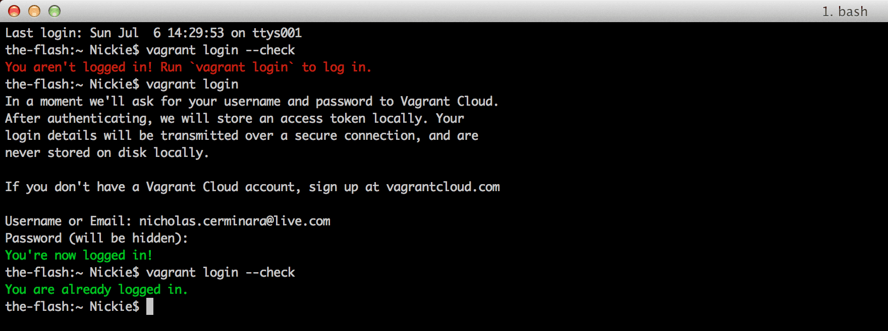
Vagrant cloud
So the command to log in to vagrant is, of course, vagrant cloud auth login but you have to have created a Vagrant account in order to be able to do this

Slide 28

Vagrant cloud
Once logged in you are able to push to a Vagrant repository AND, if you desire, make boxes “private” (which you will want to do with company boxes) so that only selected users are able to use/pull them.
This is also going to be familiar to frequent users of git private repositories…the idea here being that you want to keep your server code a secret.
From here – with your code in the cloud– you can share it with your fellow developers and, if you want, even use it on a production server

Slide 29
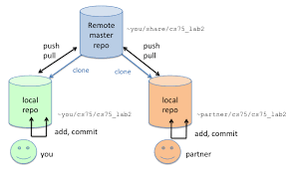
Vagrant push
When you have your box ready AND you have logged into the vagrant cloud you are ready to PUSH with:
vagrant cloud publish ORGANIZATION/BOX-NAME VERSION PROVIDER-NAME [PROVIDER-FILE]
SO- for example- you might have a command that looks like this:
vagrant cloud publish briancain/supertest 1.0.0 virtualbox boxes/my/virtualbox.box -d "A really cool box to download and use" --version-description "A cool version" --release --short-description "Download me!"

Slide 30

Managing your vagrant boxes in the cloud
Along with the basic “Create” command you can also:
vagrant cloud box delete ORGANIZATION/BOX-NAME
vagrant cloud box show ORGANIZATION/BOX-NAME
vagrant cloud box update ORGANIZATION/BOX-NAME

Slide 31
Vagrant boxes in the cloud
BUT WHAT IF….I don’t WANT to put my brand, spanking, shiny new Vagrant box in the VAGRANT cloud but I STILL want the ability to share it with the rest of my team?!?
Normally you might think “well GITHUB, right?”…but these files (even when compressed and zipped) are frequently TOO LARGE to go into git.
What if we want to keep this on a private server accessible only from the company network?

Slide 32
Vagrant boxes on your own server
THE ANSWER here is that yes- vagrant CAN push to things like FTP repositories with the following entry in your Vagrantfile:
config.push.define "ftp" do |push|
push.host = "ftp.company.com"
push.username = "username"
push.password = "password"
end
Now when you run vagrant push the box goes to the ftp server

Slide 33
Vagrant sharing
BUT WHAT IF…you only want to share with a very limited scope of people?
WHAT IF you are very proud of your vagrant box so that you want to share it via http or ssh?
vagrant share to the rescue!

Slide 34

Vagrant sharing
The command vagrant share will, by default, provide you with an http url that you can share with anyone else. WITH that http url other people can access your vagrant machine (providing that your host is publicly available)
The person with the URL does NOT need to have Vagrant installed for this to work
vagrant share ssh will allow instant ssh access to your Vagrant environment by anyone running vagrant connect –ssh on a remote computer hooked into your host. This can be used for pair programming.

Slide 35
http sharing
When you vagrant share –http Vagrant gets to work finding where the http server is running in your Vagrant environment and then ouputs the endpoint that can be used to access the machine.
$ vagrant share
==> default: Detecting network information for machine...
default: Local machine address: 192.168.84.130
default: Local HTTP port: 9999
default: Local HTTPS port: disabled
==> default: Creating Vagrant Share session...
==> default: HTTP URL: http://b1fb1f3f.ngrok.io

Slide 36
Vagrant ssh sharing
If you want to grant another developer direct ssh access to your vagrant machine you can run vagrant share –ssh and get a nice little output that will allow any other developer with direct access to your network into your vagrant machine:
==> share:
==> share: Your Vagrant Share is running! Name: bazaar_wolf:sultan_oasis
==> share:
==> share: You're sharing with SSH access. This means that another can SSH to
==> share: your Vagrant machine by running:
==> share:
==> share: vagrant connect --ssh bazaar_wolf:sultan_oasis
==> share:

Slide 37
Confused?? Good…ask questions!

